Slide 1
Machine Learning
Practical -2
Support Vector Machine
(SVM)
Lecturer:
Dr Hamid Khayyam (Australia)
Email: hamid.khayyam@rmit.edu.au

Slide 2
The aim of Machine learning methods (recap )
To find a relationship between some inputs and outputs from different engineering problems when the model is unknown (black box modelling).
To build mathematical models of engineering systems from observed input–output data (system identification) regardless of what the inputs and outputs are and make predictions based on some unseen new inputs.

Slide 3
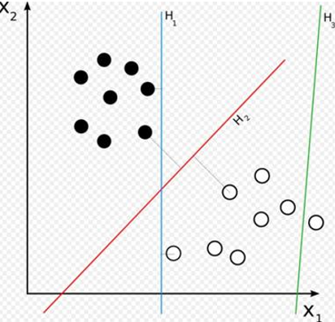
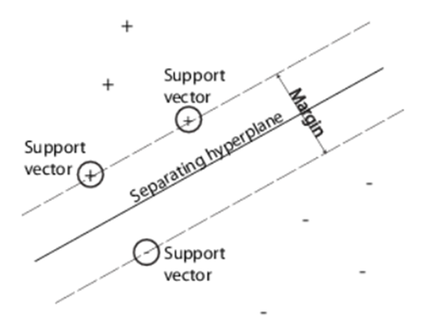
Support vector Machine (SVM) (Recap)

Slide 4

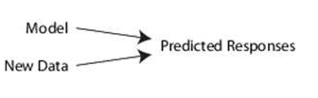
Steps of An Application of SVM (Recap)
Data pre-processing (check for missing data ,standardization)
Model development and training
Mdl = fitcsvm( X, Y) (Classification) % Mdl is the developed model
  Mdl = fitrsvm( X, Y) (Regression)
3. Simulation (prediction )
  label= predict(Mdl,X) (classification ) % label : predicted labels
  Y_predicted= predict(Mdl,X) (Regression) %Y_predicted is the predicted responses
4. Post-processing
  MSE,RMSE,R (Regression)

Slide 5
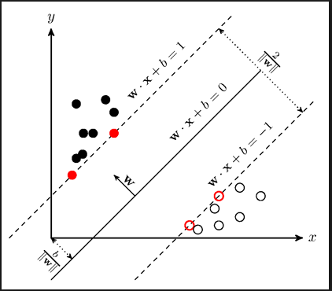

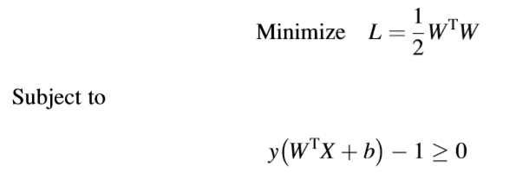
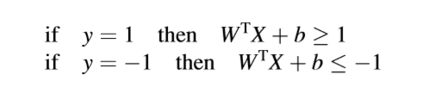

Support vector Machine (SVM) (Recap)
Training (solving ) hard-margin problem in Matlab:

Slide 6
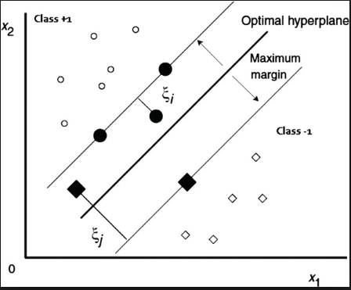
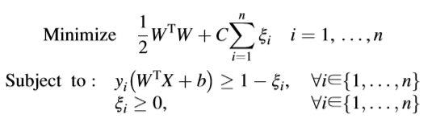
Support vector Machine (SVM) (Recap)
Non separable data (soft-margin )
.
Error
Training(solving ) Soft-margin problem in Matlab :

Slide 7
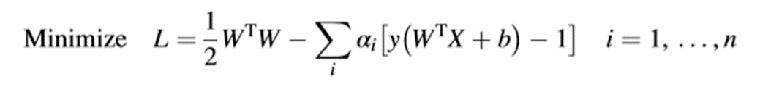
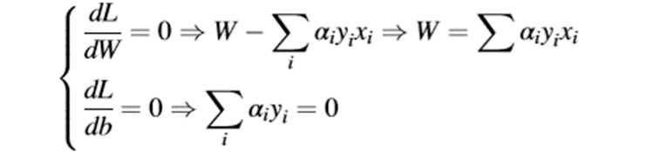
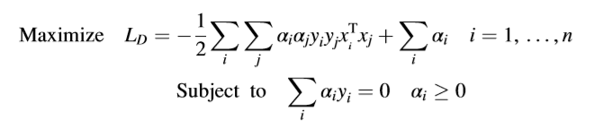
Support vector Machine (SVM) (Recap)
Solution (Lagrangian multiplier) :
α : the multiplier of the constraint.
Primal problem of SVM method
Dual problem of SVM method

Slide 8
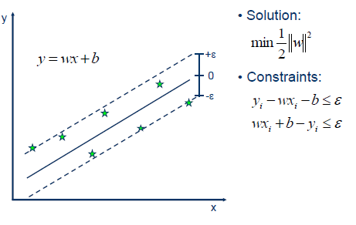
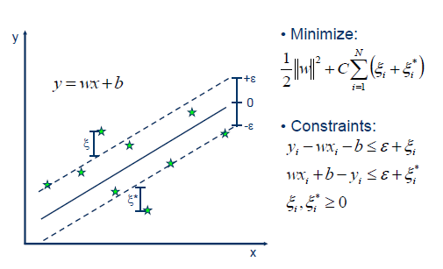


Support Vector Machine - Regression (SVR)
Support vector Machine (SVM) (Recap)
Hard-Margin Solution
$ε$: Margin of tolerance
Soft-Margin Solution
Linear SVR:

Slide 9
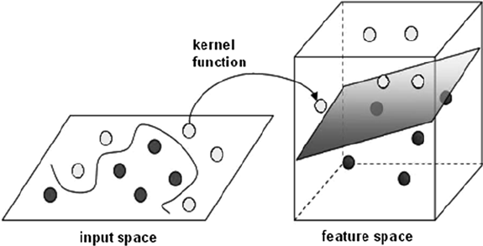
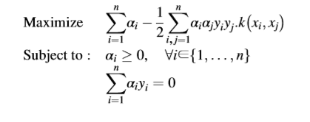

Support vector Machine (SVM) (Nonlinear)
Kernel Trick (Nonlinear SVM)
Training (solving ) problem with Kernel function in Matlab:

Slide 10
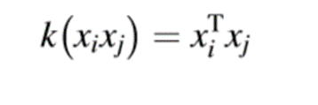



Support vector Machine (SVM) (cont.)
Kernel functions
Linear
Polynomial
RBF(Radial basis function)

Slide 11

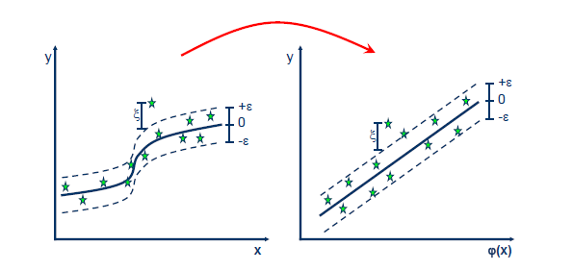
Support vector Machine (SVM) (cont.)
Nonlinear SVR

Slide 12
Support vector machine model: fitcsvm
fitcsvm
Syntax
  Mdl = fitcsvm(x, t) %trains a two-class (binary) classification .
Example :
Mdl=fitcsvm(x,t);
Predict
Syntax
ylabel = predict(Mdl,x) (Regression )
Example :
y_predicted=predict(mdl,x);

Slide 13
Support vector machine model: fitcsvm (cont.)
fitcsvm additional options:
'Standardize': false | true (Default: false) % Standardize data
'Solver': 'ISDA' | 'L1QP' | 'SMO' (Default: SMO) % Solver for objective functions
KernelFunction
'gaussian' or 'rbf': Gaussian or Radial Basis Function (RBF) kernel
  'linear': Linear kernel (default)
'polynomial': Polynomial kernel % Use 'PolynomialOrder’, q, to specify a polynomial kernel of order q.
'PolynomialOrder': positive integer (Default:3)
'KernelScale': 1 (default) | 'auto' | positive scalar % gamma in RBF kernel
'BoxConstraint': positive scalar (Default:1) % C ,the cost of misclassification

Slide 14
Support vector machine model: fitcsvm
fitrsvm
Syntax
  Mdl = fitrsvm(x, t) %trains a two-class (binary) classification .
Example :
Mdl = fitrsvm(x,t);
Predict
Syntax
y= predict(Mdl,x) (Regression )
Example :
y_predicted=predict(mdl,X);

Slide 15
Support vector regression (SVR): fitrsvm (cont.)
fitrsvm additional options:
'Standardize': false | true (Default:false)
'Solver': 'ISDA' | 'L1QP' | 'SMO' (Default: SMO)
KernelFunction:
  'gaussian' or 'rbf': Gaussian or Radial Basis Function (RBF) kernel
  'linear': Linear kernel (default)
'polynomial': Polynomial kernel. % Use 'PolynomialOrder’, q, to specify a polynomial kernel of order q.
'BoxConstraint': positive scalar (Default:1) % C the cost of wrong prediction
'KernelScale': 1 (default) | 'auto' | positive scalar % gamma in RBF kernel

Slide 16
Example of regression (Linear kernel): fitrsvm
clear;
clc;
rng(1);
x = 0:0.01:5 ;
t = sin(x)+rand(1, length(x)) ;
x = x' ;
t = t' ;
Mdl = fitrsvm(x,t,'Standardize',true);
y= predict(Mdl,x);%y is the predicted output based on model Mdl and input x
scatter(x,t); % Scatter plot
hold on
plot(x,y,'r.')

Slide 17
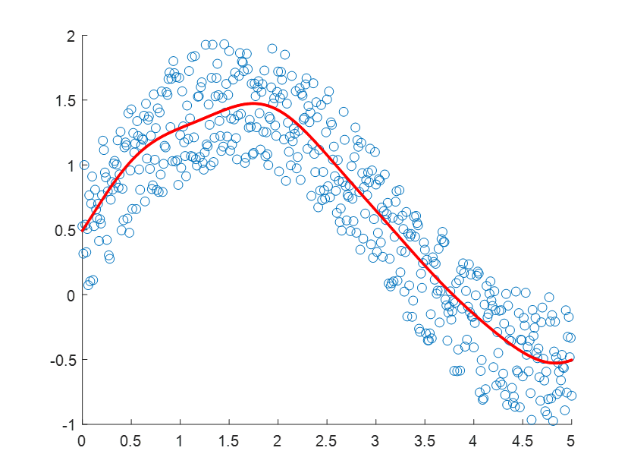
Example of regression (Gaussian kernel): fitrsvm
clear;clc;
rng(1);
x = 0:0.01:5 ;
t = sin(x)+rand(1, length(x)) ;
x = x' ;
t = t' ;
Mdl = fitrsvm(x,t,'KernelFunction','gaussian','Standardize',true);
y= predict(Mdl,x);%y is the predicted output based on model Mdl and input x
scatter(x,t); % Scatter plot
hold on
plot(x,y,'r.')

Slide 18
Example of regression (Polynomial kernel): fitrsvm
clear;clc;
rng(1);
x = 0:0.01:5 ;
t = sin(x)+rand(1, length(x)) ;
x = x' ;
t = t' ;
Mdl = fitrsvm(x,t,'KernelFunction','polynomial','polynomialorder',2,'Standardize',true);
y= predict(Mdl,x);%y is the predicted output based on model Mdl and input x
scatter(x,t); % Scatter plot
hold on
plot(x,y,'r.')

Slide 19
Example of classication-1: fitcsvm
clear ;
clc;
load ionosphere.mat
rng(1); % random number generation to reproduce results
mdl = fitcsvm(X,Y, 'KernelFunction', 'gaussian', ...
'KernelScale','auto',...
'BoxConstraint', 1, ...
'Solver','L1QP',...
'Standardize', true);% use fitcsvm with gaussian kernel and solver L1QP
y_expected=predict(mdl,X);
table( Y( 20:30 ),y_expected( 20:30 ), 'VariableNames',...
{' TrueLabel',' PredictedLabel'}) %Show the results of 20th to 30th data of the output and predicted output.

Slide 20
12×2 table
TrueLabel PredictedLabel
_________ ______________
'b' 'b'
'g' 'g'
'b' 'g'
'g' 'g'
'b' 'b'
'g' 'g'
'b' 'b'
'g' 'g'
'b' 'b'
'g' 'g'
'b' 'b'
'g' 'g'

Slide 21
Example of regression-1: fitrsvm
clear;clc;
rng(1);
Filename='SVR1.xlsx';
Sheetread='x';
Input1='A1:M252';
Sheetread1='t';
output1='A1:A252';
Input=xlsread(Filename,Sheetread,Input1); %Read Microsoft Excel
Target=xlsread(Filename,Sheetread1,output1 );
x=Input;
t=Target;

Slide 22
Example of regression-1: fitrsvm (cont.)
mdl = fitrsvm(x,t, 'KernelFunction', 'polynomial', ...
'polynomialorder',2,'Standardize', true); %To standardize the data and use polynomial function as the kernel with order 2.
yfit=predict(mdl,x); % prediction based on the developed SVR model and x as the input.
table(t(40:50,:),yfit(40:50,:),'VariableNames',{'ObservedValue',' PredictedValue'}) % show 40th to 50th data in output and predicted output
MSE_training=sum((yfit-t).^2)/numel(t); % Calculate MSE for training data
RMSE_training=sqrt(sum((yfit-t).^2)/numel(t)); % Calculate RMSE for training data

Slide 23
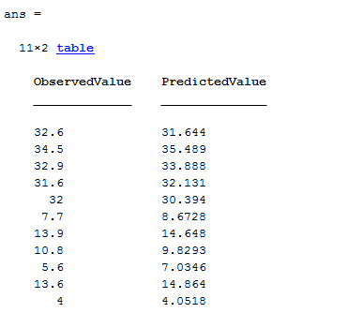
Example of regression-1: fitrsvm (cont.)
MSE training = 11.9979
RMSE training = 3.4638

Slide 24
Example of regression-2: fitrsvm
clear;clc;
rng(1);
Filename='SVR2.xlsx';
Sheetread='x';
Input1='A1:A94';
Sheetread1='t';
output1='A1:A94';
Input=xlsread(Filename,Sheetread,Input1); %Read Microsoft Excel
Target=xlsread(Filename,Sheetread1,output1 );
x=Input;
t=Target;

Slide 25
Example of regression-2: fitrsvm (cont.)
mdl = fitrsvm(x,t, 'KernelFunction', 'gaussian', ...
'Solver','L1QP',...
'Standardize', true); %standardize the data and use Gaussian kernel.
yfit=predict(mdl,x); % prediction based on the developed SVR model and x as the input
table(t(20:30,:),yfit(20:30,:),'VariableNames',{'ObservedValue',' PredictedValue'}) % show 20th to 30th data in output and predicted output
MSE_training=sum((yfit-t).^2)/numel(t); % Calculate MSE for data ;numel :number of elements
RMSE_training=sqrt(sum((yfit-t).^2)/numel(t)); % Calculate RMSE for data ;numel :number of elements

Slide 26
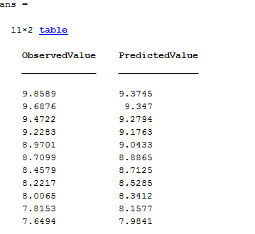
Example of regression-2: fitrsvm (cont.)
MSE_training = 0.6481
RMSE_training = 0.8051

Slide 27
Example of regression-3: fitrsvm
clear;clc;
rng(1);
Filename='SVR3.xlsx';
Sheetread='Sheet1';
Input1='A1:B89';
output1='C1:C89';
Input=xlsread(Filename,Sheetread,Input1); %Read Microsoft Excel
Target=xlsread(Filename,Sheetread,output1 );
Sheetread1='Sheet2';
Input2='A1:B11';
Target2 ='C1:C11';
Inputnew=xlsread(Filename,Sheetread1,Input2);
Targetnew=xlsread(Filename,Sheetread1,Target2 );

Slide 28
Example of regression-3: fitrsvm (cont.)
x=Input;
t=Target;
xnew=Inputnew;
tnew=Targetnew;
x=fillmissing(x,'spline'); %fill in the missing input data
t= fillmissing(t,'spline'); %fill in the missing output data
mdl=fitrsvm(x,t,'Standardize',true,'KernelFunction','gaussian','epsilon',0.3); %standardize the data and use gaussian kernel to develope and model the data
yfit=predict(mdl,x); % prediction based on the developed SVR model and x as the input
MSE_training=sum((yfit-t).^2)/numel(t); % Calculate MSE for data

Slide 29
Example of regression-3: fitrsvm (cont.)
RMSE_Training=sqrt(sum((yfit-t).^2)/numel(yfit)); % Calculate RMSE for training data
table(t(60:70,:),yfit(60:70,:),'VariableNames',{'ObservedValue',' PredictedValue'}) % show 60th to 70th data in output and predicted output
ynew=predict(mdl,xnew);% prediction based on new data
MSE_testing=sum((ynew-tnew).^2)/numel(tnew); % Calculate MSE for new data
RMSE_Testing=sqrt(sum((ynew-tnew).^2)/numel(ynew)); % Calculate RMSE for new data

Slide 30
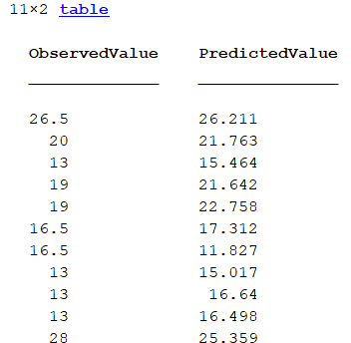
Example of regression-3: fitrsvm (cont.)
Without kernel (linear kernel)
RMSE_training = 3.5404
RMSE_testing = 7.7213

Slide 31
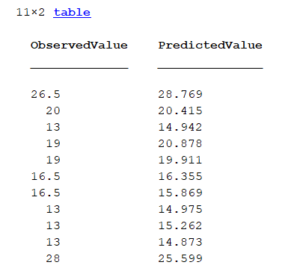
Example of regression-3: fitrsvm (cont.)
With kernel (Gaussian kernel)
RMSE_training = 2.8585
RMSE_testing = 7.5712

Slide 32
Example of regression-4: fitrsvm
clear;clc;
rng(1);
Filename='SVR4.xlsx';
Sheetread='Sheet1';
Input1='A1:H72';
output1='I1:I72';
Input=xlsread(Filename,Sheetread,Input1); %Read Microsoft Excel
Target=xlsread(Filename,Sheetread,output1 );
x=Input;
t=Target;
Sheetread1='Sheet2';
Input2='A1:H3';
Target2 ='I1:I3';

Slide 33
Example of regression-4: fitrsvm (cont.)
Inputnew=xlsread(Filename,Sheetread1,Input2);
Targetnew=xlsread(Filename,Sheetread1,Target2 );
xnew=Inputnew;
tnew=Targetnew;
mdl = fitrsvm(x,t, 'KernelFunction', 'gaussian', ...
'Standardize', true); %standardize the data %standardize the data and use gaussian kernel to develope and model the data
conv = mdl.ConvergenceInfo.Converged; % Shows whether the program reach an answer
iter = mdl.NumIterations; % number of iteration to reach the answer
yfit=predict(mdl,x); % prediction based on the developed SVR model and x as the input

Slide 34
Example of regression-4: fitrsvm (cont.)
table(t(20:30,:),yfit(20:30,:),'VariableNames',{'ObservedValue',' PredictedValue'}) % show 20th to 30th data in output and predicted output
MSE_training=sum((yfit-t).^2)/numel(t); % Calculate MSE for data
RMSE_training=sqrt(sum((yfit-t).^2)/numel(t)); % Calculate RMSE for data
ynew=predict(mdl,xnew);
table(tnew(:),ynew(:),'VariableNames',{'ObservedValue_Newdata',' PredictedValue_newdata'}) % show data in output and predicted output
MSE_testing=sum((tnew-ynew).^2)/numel(tnew); % Calculate MSE for new data
RMSE_testing=sqrt(sum((tnew-ynew).^2)/numel(tnew)); % Calculate RMSE for new data
Errorpercentage=((ynew-tnew)./tnew)*100; % Calculate error percentage for tnew and ynew

Slide 35
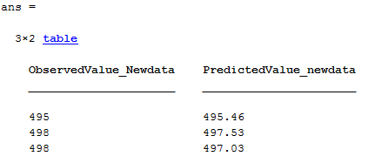
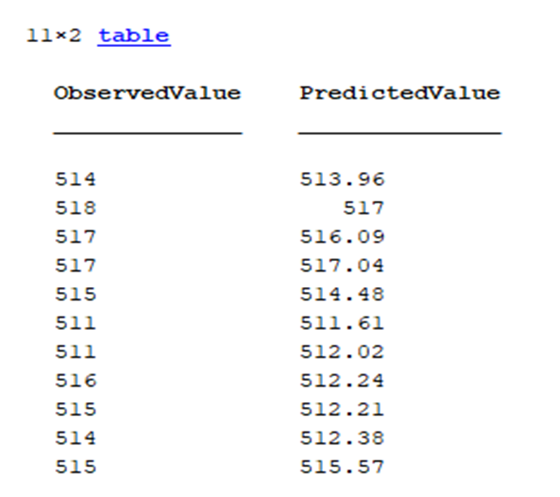
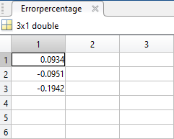
Example of regression-4: fitrsvm (cont.)
Without kernel (linear kernel)
MSE_training = 3.8295
RMSE_training = 1.9569
RMSE_testing = 0.6765
MSE_testing = 0.4576

Slide 36
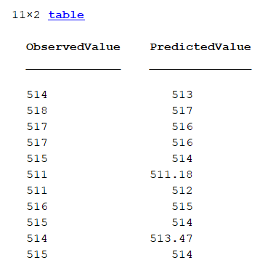
Example of regression-4: fitrsvm (cont.)
With kernel (linear kernel)
MSE_training =2.1296
RMSE_training = 1.4593
MSE_testing=4.4638
RMSE_testing = 2.1128

Slide 37
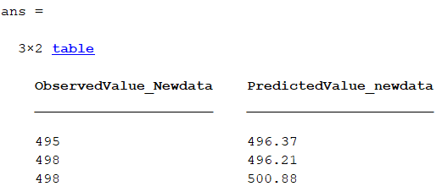
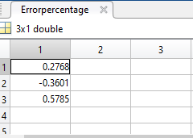
Example of regression-4: fitrsvm (cont.)

Slide 38
SVM References
https://au.mathworks.com
S. Araghinejad, Data-Driven Modeling: Using MATLAB® in Environmental Engineering
http://www.saedsayad.com/support_vector_machine_reg.htm
https://digitaltransformationpro.com/data-mining-steps/

